Slide 1
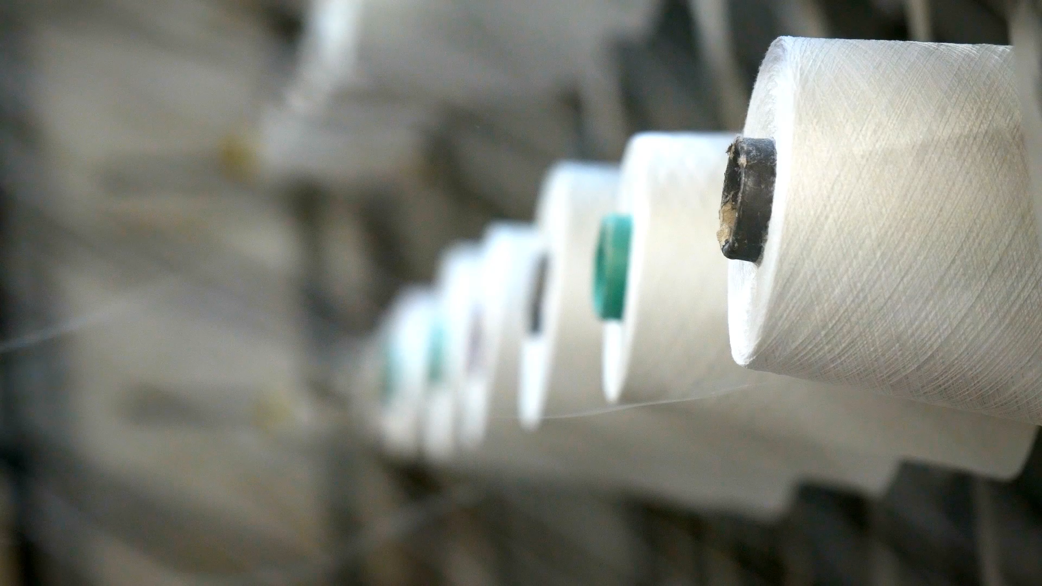
Textile waste predictions based on economic indicators
By Kristin Scully

Slide 2
Overview
Problem
Data
Assumptions
Results
Conclusions
Next Steps
References

Slide 3
What’s the problem?
The worldwide volume of textile production has grown from 23.9 million metric tons in 1975 to 113.8 million metric tons in 2022. (Statista, 2023) That is a 376% increase in production in less than 50 years.
Only 13% of clothing is eventually recycled. (Ellen Macarthy Foundation, 2017) About 35.7 million tons were wasted in 2018. (Municipal Solid Waste)
Goal: to identify a relationship between economic events and the amount of textile waste produced by consumers in the United States.

Slide 4

Research Question
Can we predict how much textile waste will be generated in the future based on economic factors?

Slide 5

How can we use this information?
Create incentive campaigns for recycling textiles
Improve waste management protocols
Apply for grants for research and technology
To improve technology and produce customized garments (3D Printing)
Develop biodegradable textiles
Understand consumer behavior at the end of a garment's life

Slide 6
Data
US GDP from 1950 to Q3 2023 from fred.stlouis.gov
Monthly Consumer Price Index of clothing and footwear for all US not seasonally adjusted from 2012 to 2023
Yearly personal consumption expenditures of clothing, footwear, and related services from 1929 to 2022
Yearly inflation of consumer prices for the United States from 1960 to 2022
Municipal solid textile waste including data from 1960 – 2018
Monthly US Recession data from 1854-2023

Slide 7
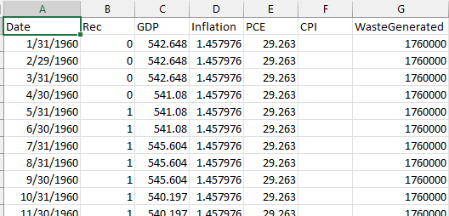
Data
Quarterly
Gross Domestic Product (GDP)
Monthly
Recession
Consumer Price Index (CPI)
Yearly
Personal Consumption Expenditure (PCE)
Inflation
Municipal Solid Waste
Since we have Municipal Solid Waste data from 1960 to 2018, we will use the economic indicators to predict the waste generation from 2019-2022
Notes:
Yearly because those are the only rows with all the information. Already making predictions on predictions, I didn’t want to use machine learning to fill in the predictor variables.
Removed CPI because there was too much missing information for it to be valuable.

Slide 8
Correlations
 | Rec | GDP | Inflation | PCE | WasteGenerated
Rec | 1.000
GDP | -0.109 | 1.000
Inflation | 0.187 | -0.326 | 1.000 | -0.318
PCE | -0.175 | 0.976 | -0.318 | 1.000
WasteGenerated | -0.457 | 0.998 | -0.645 | 0.984 | 1.000
As GDP and PCE increase, waste generation also increases.
As Inflation decreases, waste generation increases.

Slide 9

Assumptions
Normalization
Modeled both normalized data and non-normalized data.
For normalized data I validated by doing a one-way ANOVA test.
For non-normalized data I validated by doing a Kruskal-Wallis test.

Slide 10
Methods
Seven regression models
Multiple Linear Regression
Decision Tree Regression
Random Forest Regression
Lasso Regression
Polynomial Regression
Naïve Bayes Regression
Gradient Boosting Regression

Slide 11

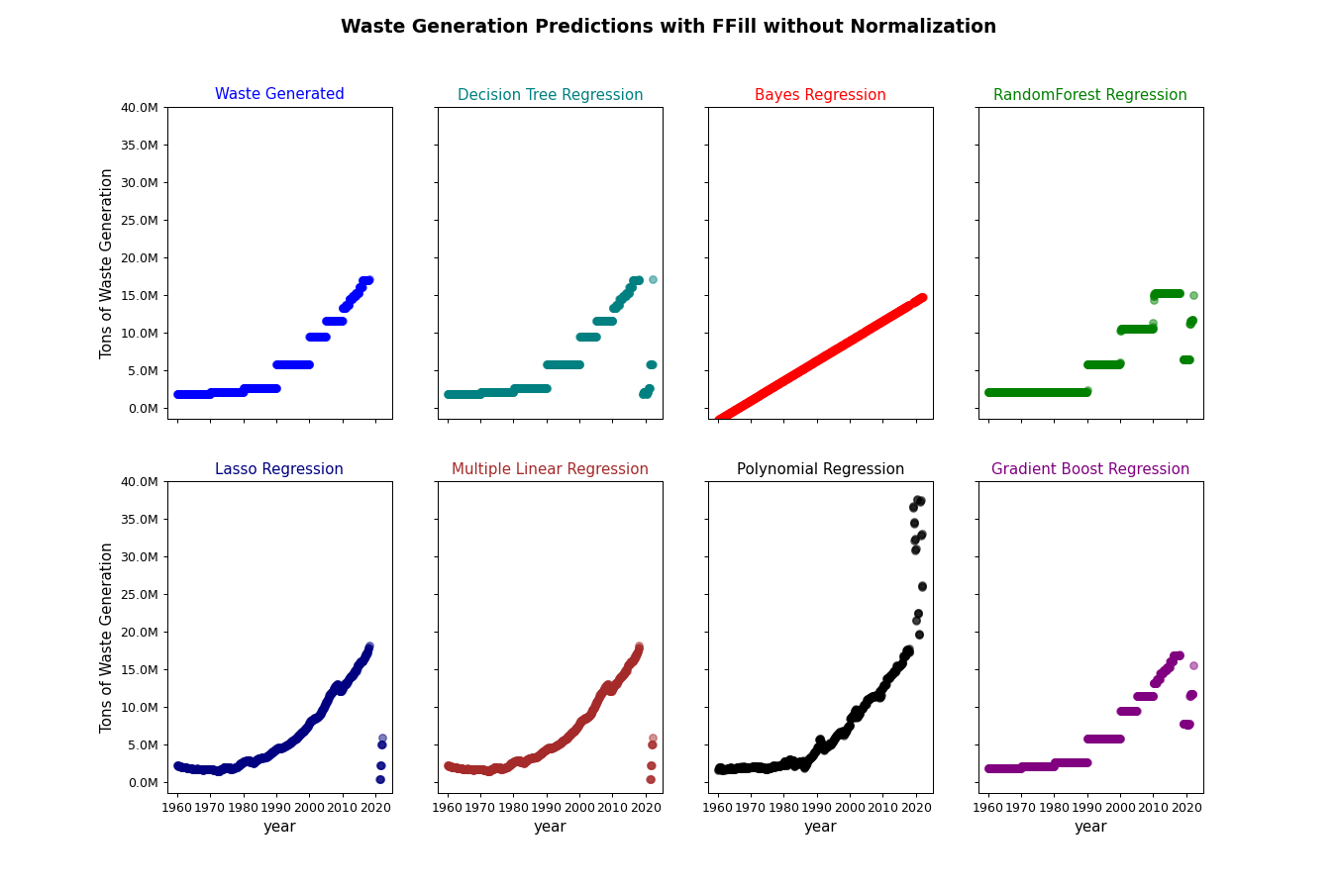
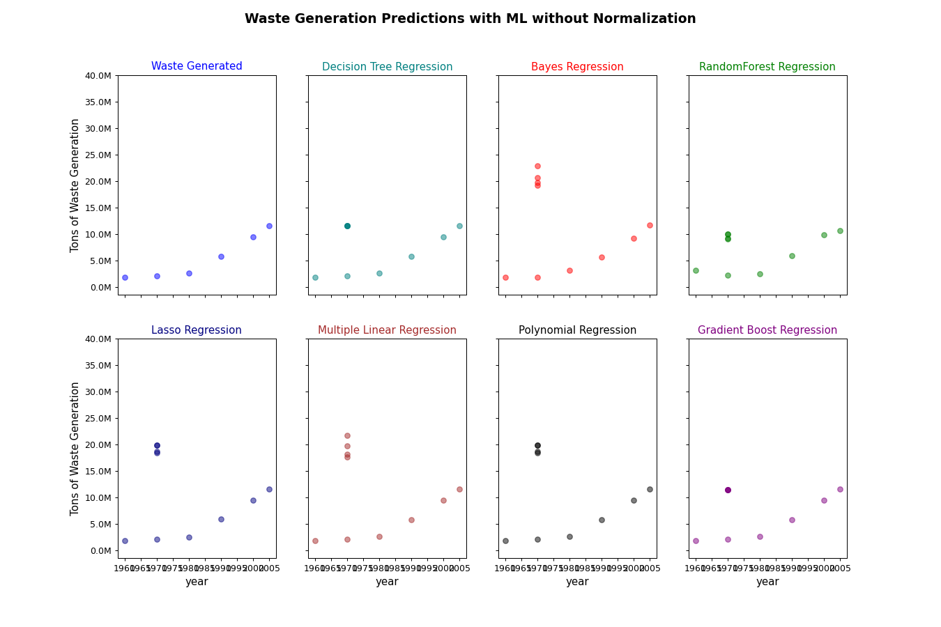
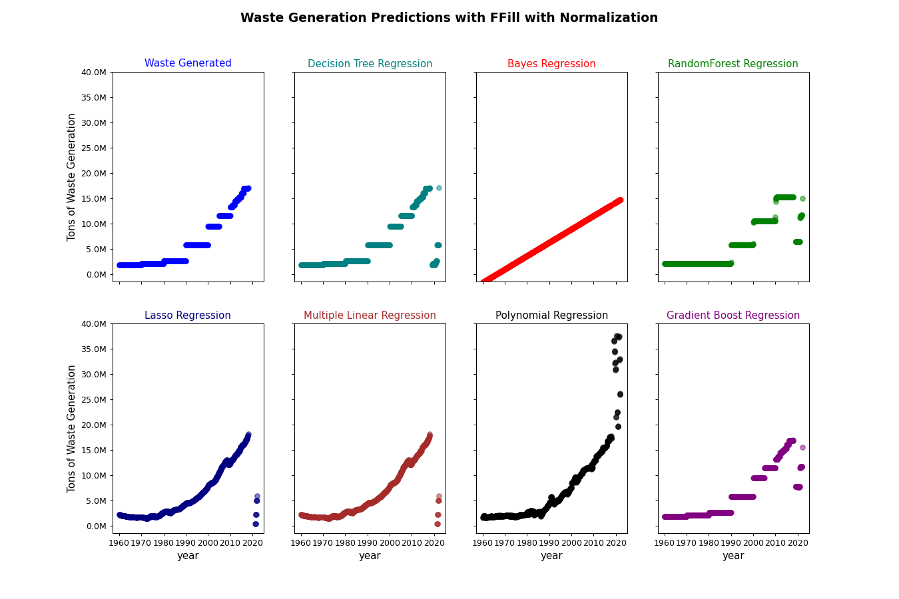
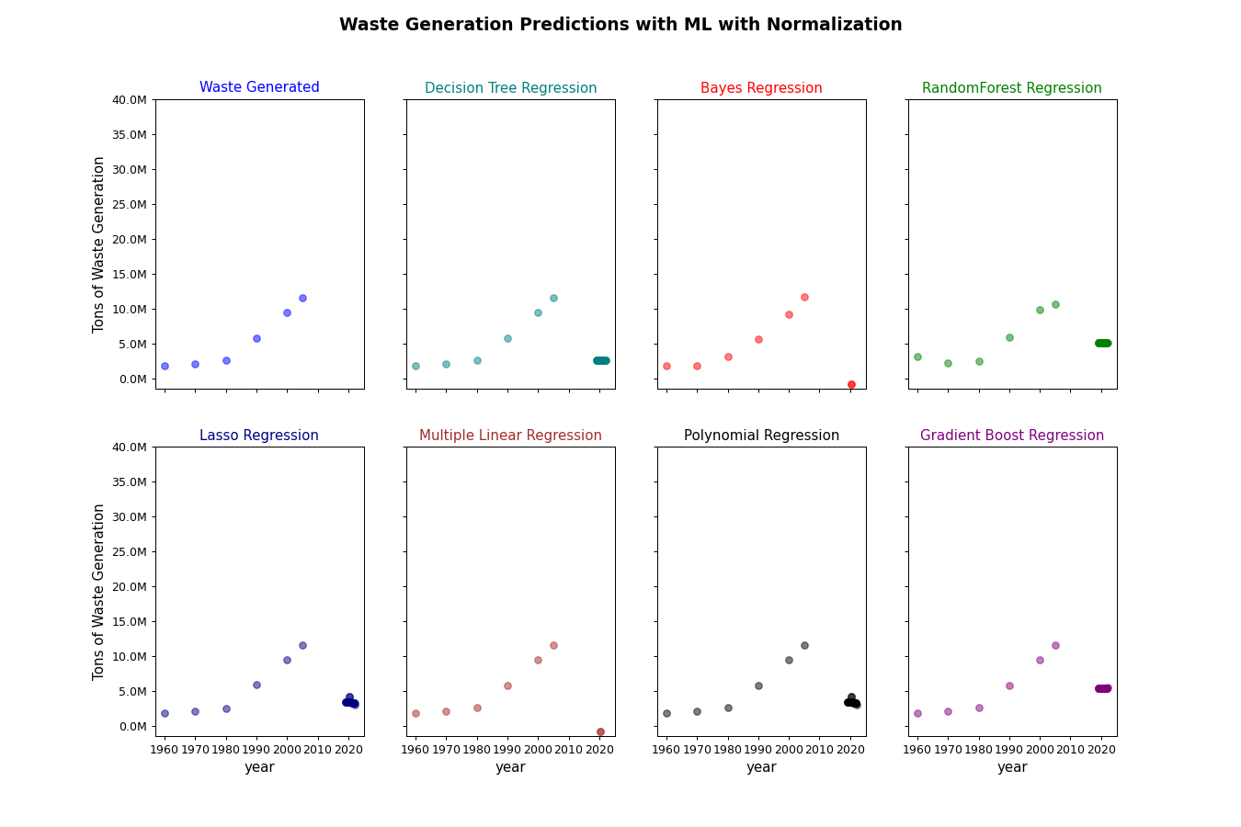
Results

Slide 12
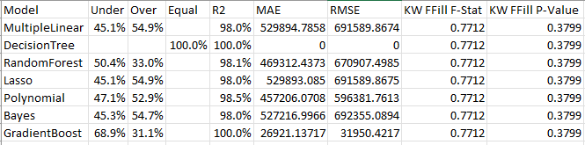
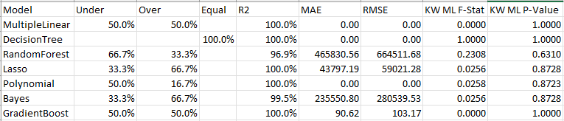
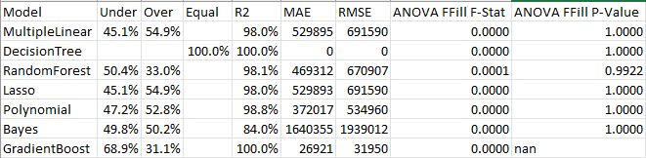
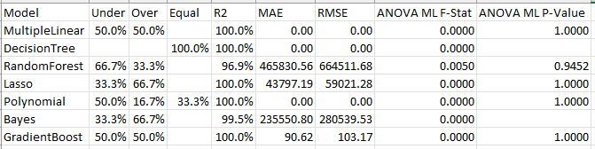
Validation

Slide 13
Problems with over/under-predicting
Over-predicting
Allocating too many funds to the waste management and recycling infrastructure (both government and businesses)
May divert funds away from another environmental causes
Ineffective policy changes
Discourage investment with stakeholders perceiving the problem as less urgent than it is
Under-predicting
Inadequate resources being allocated leading to insufficient waste management and environmental consequences
Lax regulations that fail to address the full magnitude of the waste problem
Missed opportunities for innovation and investment in sustainable practices
Inadequate support to communities affected by textile waste

Slide 14
Conclusion
As GDP rises, so does waste generation.
Normalization slightly improved the regression models
Overall, the results were poor for every model because the economic factors chosen did not explain the waste generation
The regression model you choose doesn’t matter if the predictor variables don’t explain the target variable
More effort is needed to find variables that correlate with the target variable

Slide 15
Next Steps
Find or develop predictor variables that better explain the waste generation.
Research waste management processes within the largest textile producers
Do more sustainable producers produce less waste?
Can implementation of new technologies reduce the waste generation of textiles?
Things Learned:
Be prepared to pivot your research during the EDA stage, when you find out the relationship between predictor variables and target variables

Slide 16
References
Ellen Macarthur Foundation. (n.d.) A new textiles economy: Redesigning fashion’s future. Ellen Macarthur Foundation. https://www.ellenmacarthurfoundation.org/a-new-textiles-economy
Scully, K. (2023) Internet of things – Technology as a waste solution for the textile supply chain. Department of Computer Science, Regis University. pp. 2-14.

Slide 17
EDA

Slide 18
More EDA

Slide 19

More EDA

Slide 20
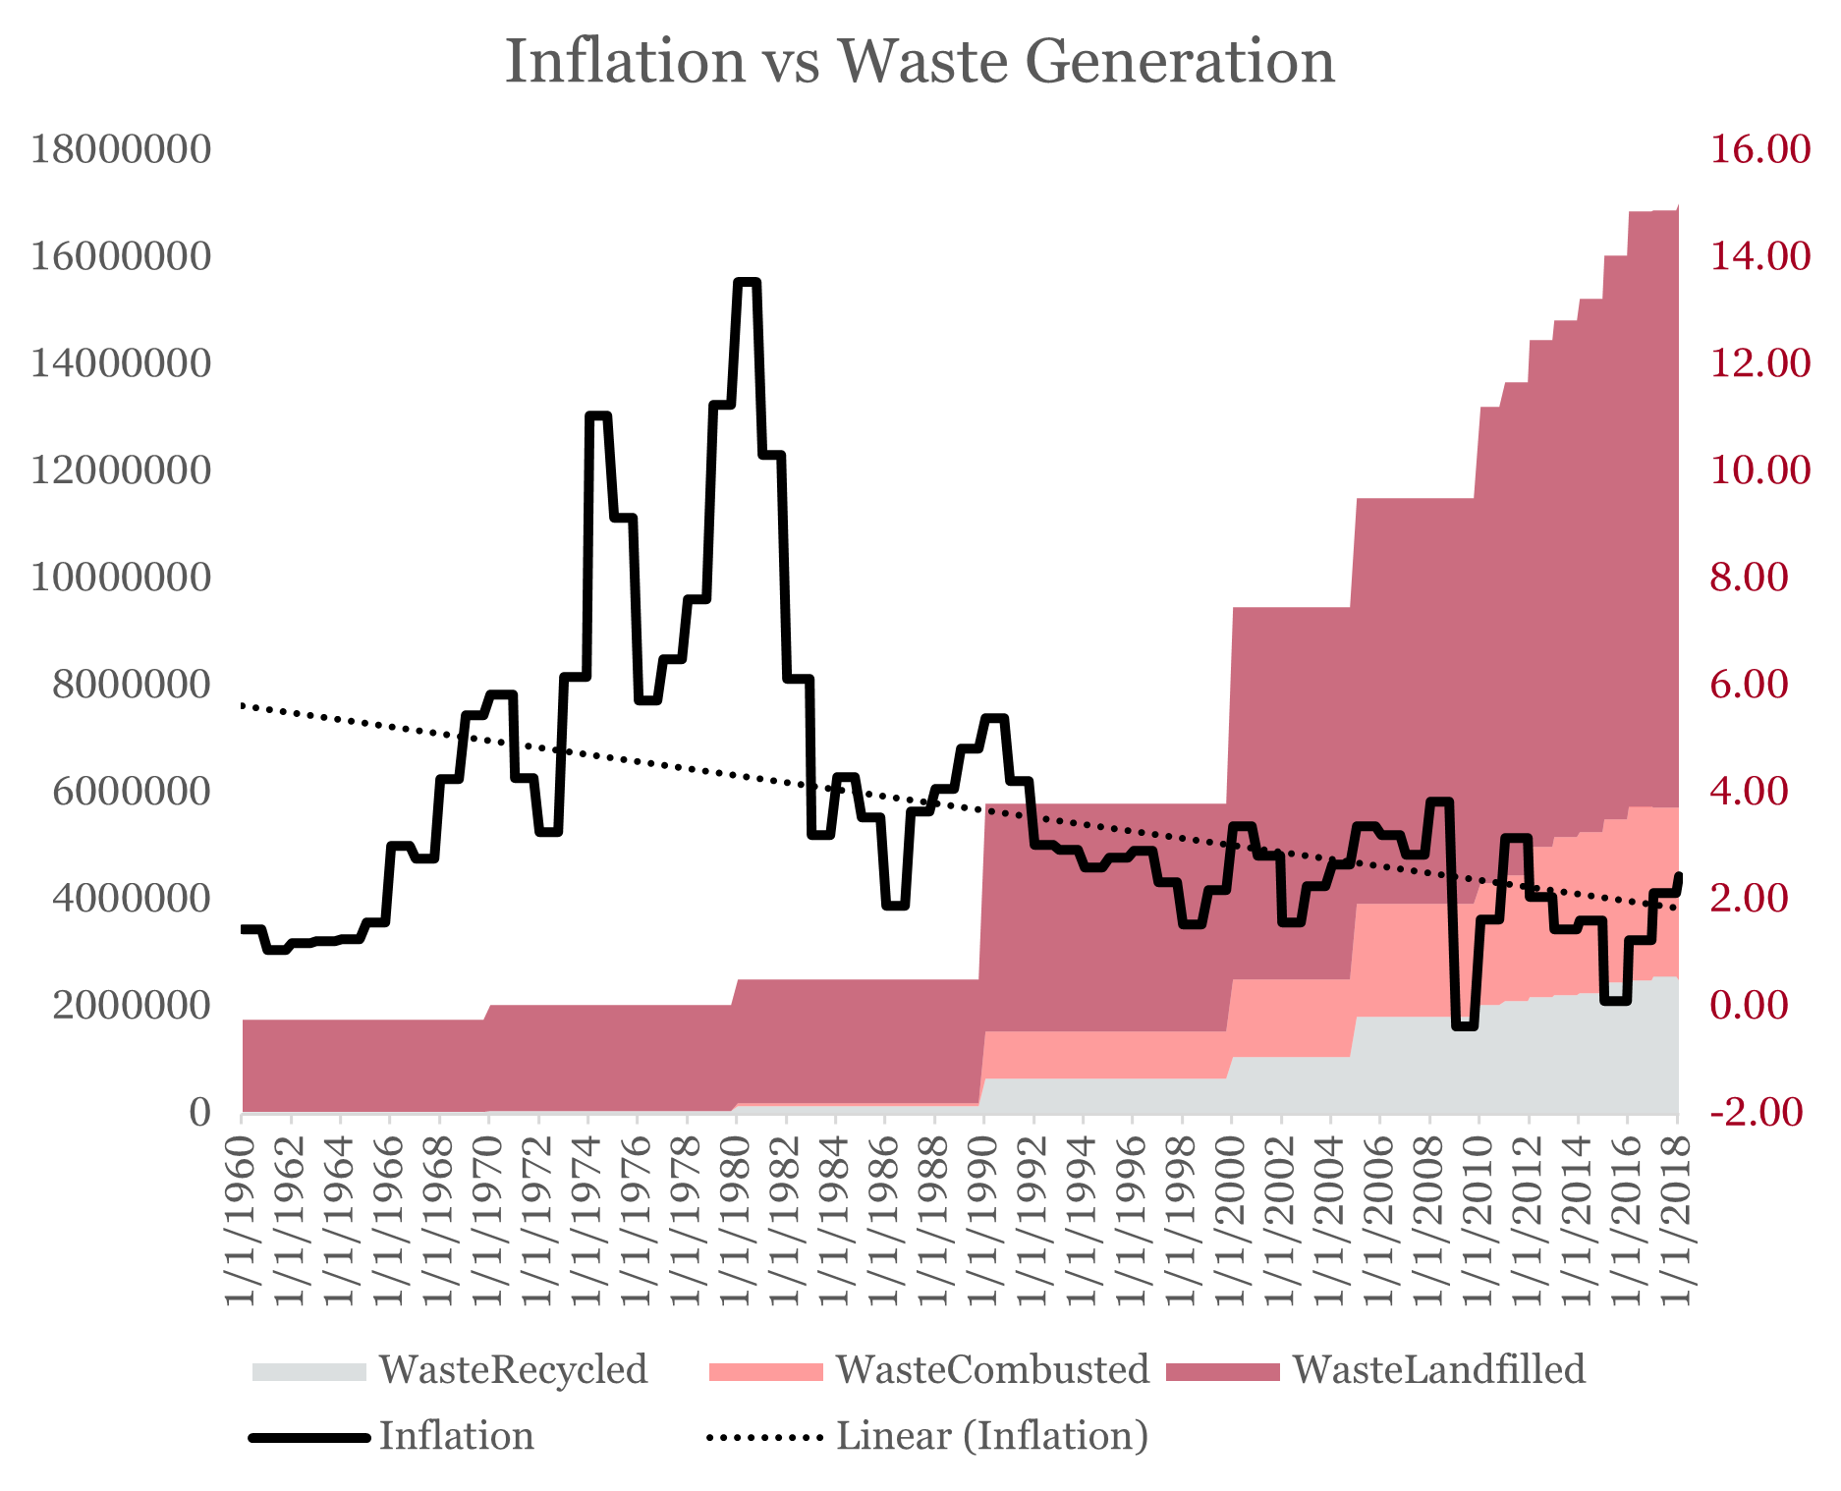
More EDA

